Slide 1
Lecture 3: Circuit Partitioning – I
Tsung-Wei (TW) Huang
Department of Electrical and Computer Engineering
University of Utah, Salt Lake City, UT
Notes:
Hello folks, today we are moving on to the first exciting problem of physical design, the circuit partitioning problem. This is a problem to break down a large circuit into several small pieces where each piece represents a problem that can be managed in reasonable amount of time and effort.

Slide 2
Recap: Empirical Analysis
On modern computers (e.g., Intel i5/i7 2.5-3.5GHz)
O(N) = 1000000 ~ 8000000 takes about 1s to finish
Generally true on modern PCs
Big-O complexity for an input size N
O(N)
for(int i=1; i<=N; i++) some_constant_work();
O(N²)
for(int i=1; i<=N; i++)
for(int j=1; j<=N; j++)
some_constant_time_work();
O(N³), O(N⁴)…
How long does these loops take?
(when N = 1000 & 1000000)
Notes:
Let’s refresh what we have learned from the last lecture. Last time we have talked about using Big-O notation to measure the runtime complexity of an algorithm. You describe a complexity in terms of the input size and then compare different ones at the worst-case. If your big-O complexity is larger than mine, your algorithm is considered to be bad. However, big-O does not give you any practical sense about how long that algorithm is going to take.
So, we talked about the empirical analysis based on my 10-year programming experience. I told you roughly how much time it is going to take for a big-O complexity. On a modern computers (like intel i6 or i7 at 2.5 or 3.5 GHz), running a big-O N algorithm with N equal to 1M to 8M takes about 1 second.
For example, (explain)

Slide 3
Recap: World of NP (Assuming P != NP)
There is a strong belief that P≠ NP, due to the existence of NPC problems.
NP-Hard
NP
NPC
P
Notes:
Then, we talked about complexity classes as a measure to tell us how difficult a problem is and how intractable it is compared to other classes.
We talked about four classes, P class, NP class, NPC class, and NP-hard class. (explain the definition for each class).
In general, if your problem can be solved in P class, that’s the best, because you can come up with efficient polynomial algorithms to handle it. If it belongs to NPC or NP-hard, then the problem is quite difficult because to the best knowledge of the computer scientists we have not yet found any efficient algorithms to solve that problem.

Slide 4
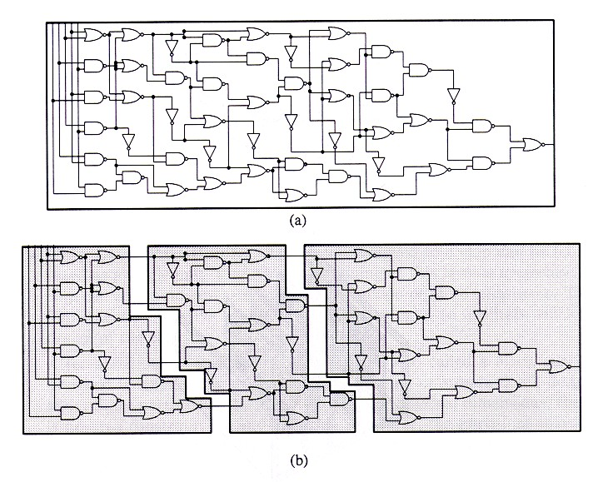
Physical Design Flow
Notes:
Before we move on to the physical design flow, any question?
We have seen this chart before. It shows the entire circuit design flow starting from high-level specification of a design, … (explain)
In terms of physical design, it is a very complicated stage with many difficult problems to solve. First, you will need to partition the circuit into several small blocks such that you are not dealing with the original very big circuit to run into any complexity issue. (explain Floorplan …)
So, the first step we are going to focus in today’s and probably the next two lectures is circuit partition. We are going to look at some famous algorithms to partition the circuit and you will need to implement a classical circuit partitioning algorithm in the first programming assignment.

Slide 5
Circuit Partition
An essential step for reducing algorithm design complexity
Divide and conquer (D&C)
Input
A circuit graph
Output
A set of partitioned subgraphs
Objective
Minimize cross-connection
Notes:
Circuit partition is an essential step for reducing algorithm design complexity because you break down a big problem into a set of smaller blocks each with a more manageable complexity. Now you can probably imagine that being to partition a circuit is very important for implementing algorithms like divide and conquer (explain what divide and conquer is)
So the problem is that, you are given a circuit … (explain)

Slide 6
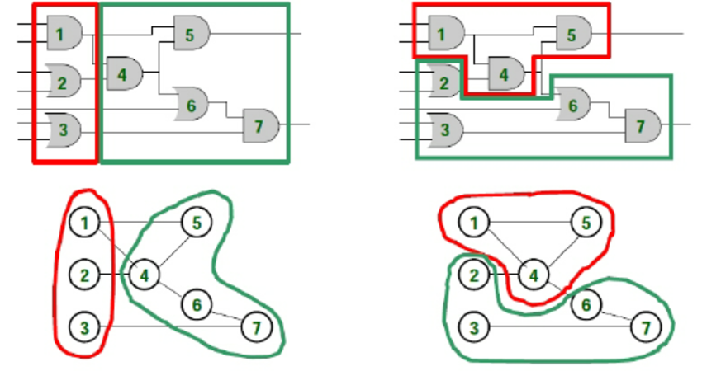
Circuit Partition Example
Which partition is better in terms of cross-connection count?
Notes:
This is an example of circuit partition. Here, we show two different results both partition the same circuit into two pieces. One piece is marked in red and another piece is marked in green. (explain …)
The question here is which partition is better in terms of cross-connection count?

Slide 7
Importance of Circuit Partition
Divide & Conquer design methodology
The most effective way to solve problems of high complexity
Ex: min-cut based placement, partitioning-based test generation, …
System-level partitioning for multi-chip designs
Inter-chip interconnection delay dominates system performance
Circuit emulation/parallel simulation
Partition large circuit into multiple FPGAs or multiple special-purpose processors
Parallel CAD development
Task decomposition and load balancing among partitions
Notes:
So, summarizing the importance of circuit partition – (explain each item)
As a result, you can clearly see circuit partition is quite important not just for the circuit performance itself but also critical for designing efficient physical design algorithms because the way you partition a circuit into blocks is situated at the top most layer of the whole physical design flow. If you make a wrong decision at the partition, you are very unlikely to recover the loss or cost of that wrong partition.
This is like you decide to partition your time at this stage to do A and B, and if that decision is wrong, then you end up wasting a lot of time on A or B, which could otherwise be used for some other useful things. That’s the importance of partition.

Slide 8
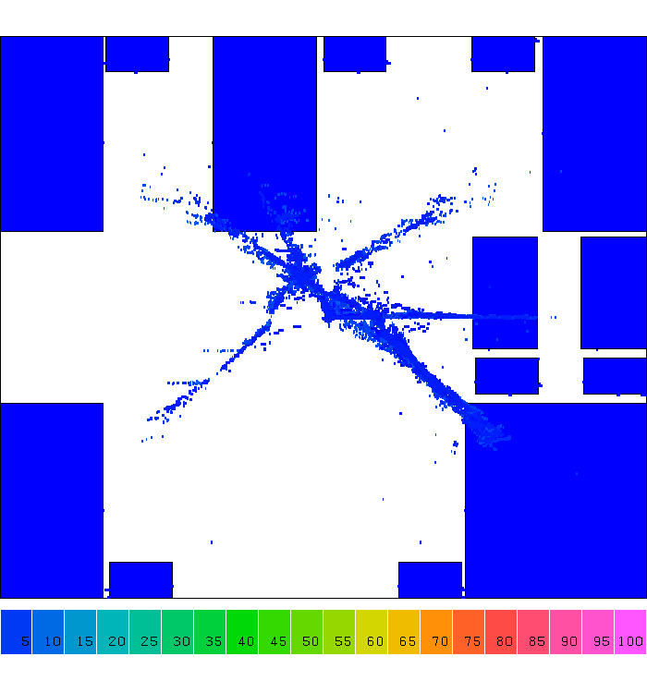
Application: D&C-based Placement
Notes:
We have seen this example already. It demonstrates how a real-life circuit is being placed using partition-based algorithm. Initially, you see a bunch of logic gates, you know, hundreds of millions of gates, being placed and lumped together at the center of the circuit. The goal is to place them in a proper location such that they don’t overlap. And, a common algorithm of doing this is to iteratively partition the circuit horizontally and vertically, and then place gates in each partition individually.

Slide 9
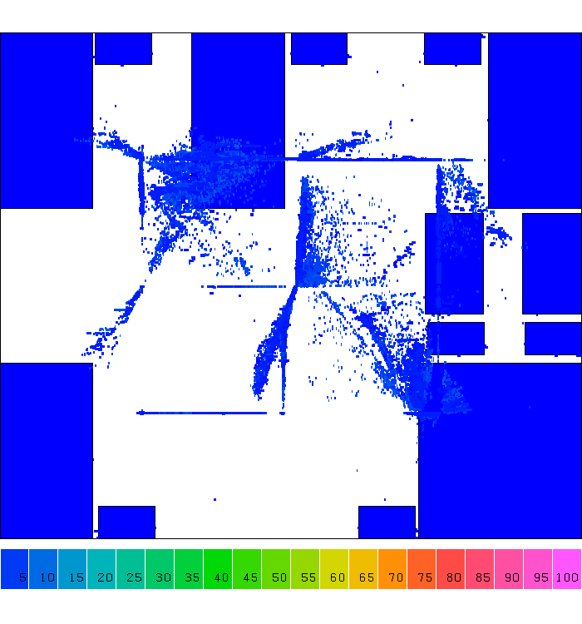
Application: D&C-based Placement

Slide 10
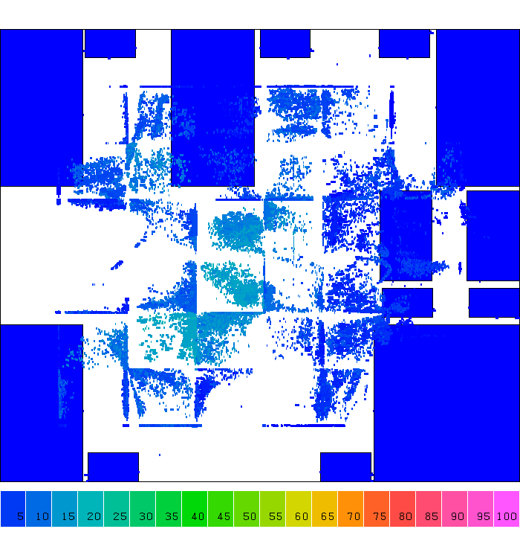
Application: D&C-based Placement

Slide 11
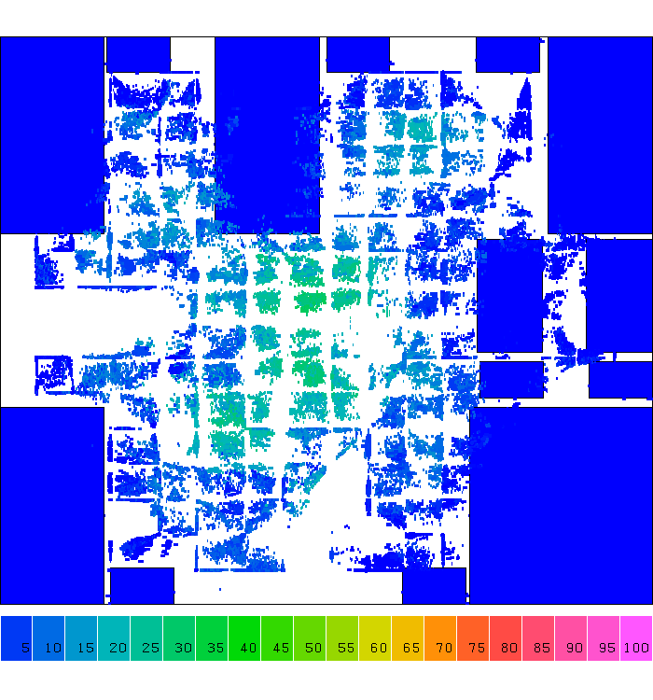
Application: D&C-based Placement

Slide 12
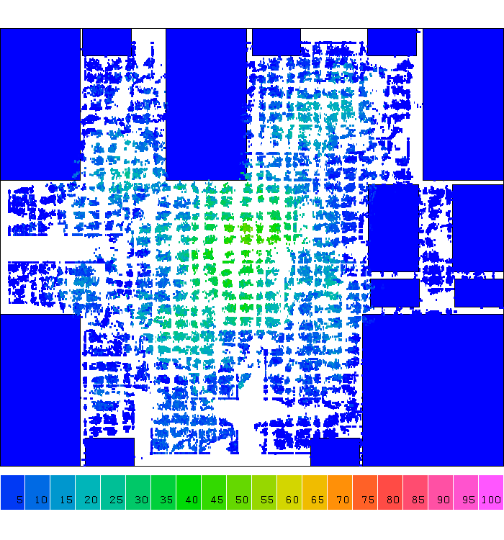
Application: D&C-based Placement

Slide 13
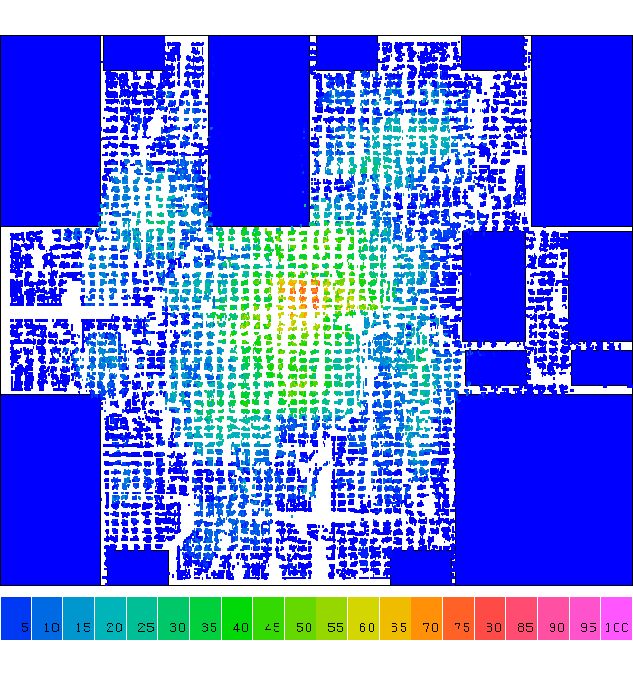
Application: D&C-based Placement

Slide 14
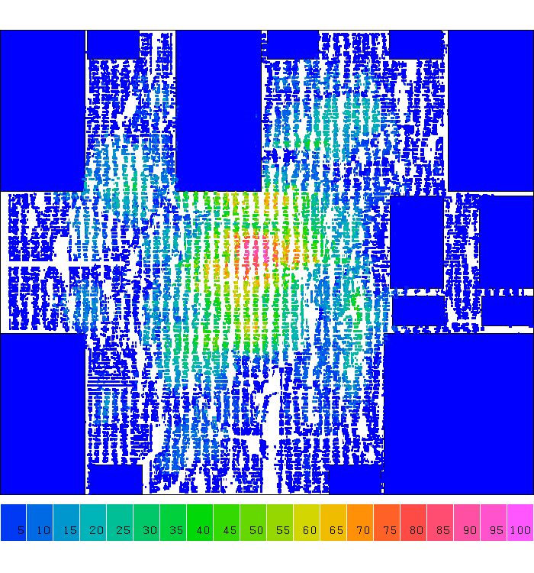
Application: D&C-based Placement

Slide 15
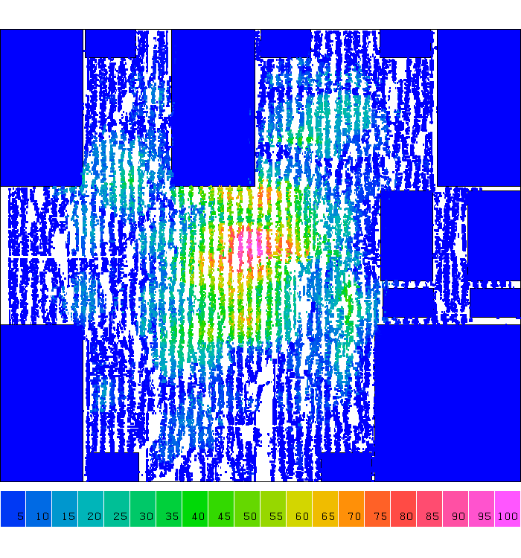
Application: D&C-based Placement
Notes:
So, from iteration to iteration you can clearly see cells are placed very regularly, right, Cells are spreading along the 2D grid partition. We partition the large chip care into smaller grids and place cells in those small grids. Solving the smaller grid problem is definitely more efficiently than directly handling the original problem.
This is one example of how partition is used in solving physical design problems.

Slide 16

Idea Time
Input
A circuit graph
Output
A set of partitioned subgraphs
Objective
Minimize cross-connection
How do you solve it?
Any idea is welcome!
Notes:
Before we move on, I want to stop here for 5 min and ask you to form a group of 3-4 people. Brainstorm and discuss in a team how you will solve the circuit partitioning problem, if I give you a circuit or a graph and ask you to partition the circuit graph into two pieces with approximately the same size while minimizing the total number of cross-connection. Again, discuss how you will solve the circuit partition problem for breaking a input circuit graph into a set of subgraphs, and the number of connections between the two partitions is kept as minimum as possible.

Slide 17
Terminology
Partitioning
Dividing bigger circuits into a small number of partitions (top down)
Clustering
Cluster small cells into bigger clusters (bottom up)
Covering / Technology Mapping
Clustering such that each partition (cluster) has special structure
k-way Partitioning
Dividing into k partitions
Bipartitioning
2-way partitioning (e.g., k=2, two-way partitioning)
Bisectioning
Bipartitioning two partitions that have the same (or balanced) size
Notes:
Let’s talk about some important terminology for circuit partitioning. (explain …)

Slide 18
Circuit Representation
Circuit netlists
Gates: A, B, C, D
Nets: {A,B,C}, {B,D}, {C,D}
Hypergraph
Vertices: A, B, C, D
Hyperedges: {A,B,C}, {B,D}, {C,D}
Vertex label: Gate size/area
Hyperedge label: Importance of net (weight)
B
A
C
D
B
A
C
D
Notes:
The circuit network is represented as a set of gates and a set of nets, where we called netlist. Each gate represents a particular logic element, such as AND gate, NOT gate, OR gate, and so on. Each net represents a connection for a group of nets or from an output of a gate to several inputs of gates. For instance (explain the example)
You probably already realize the circuit graph is not a typical graph we are familiar with, you know in that typical graph each edge connects to exactly two nodes. However, in circuit representation, we are concerned with hypergraph. And the definition of a hyper graph is that each edge connects to an arbitrary number of gates, more than two. For instance, in the net {A, B, C}, gate A connects to two nodes B and C. So we say in the hypergraph definition, the circuit graph has four vertices (explain …)
Of course, since the circuit network has direction for which signals are going to which signals, we can always make it a typical graph without hyper edges. For example, in the net {A, B, C}, we know the direction of the signal … (explain)
With this, we can design two different partitioning algorithms, one for the typical graph that doesn’t have hyperedges and another one for the hypergraph.

Slide 19
Circuit Partition Objective Formulation
Minimize interconnections between partitions
c(X,X’)
X
X’
Minimum cut: min c(x, x’)
Minimum bisection: min c(x, x’) with |x|= |x’|
Minimum ratio-cut: min c(x, x’) / |x||x’|
Notes:
With those knowledge, let’s formulate the objective of a circuit partition problem. Assuming you have two partitions, X and X prime, and the number of cross connections between X and X’ is called “cut”, denoted as c(X, X’). (explain …)
Now, if we combine both minimum cut and minimum bisection, we can write down the objective as minimizing (explain …).
Why are we having this term in the denominator? In other words, why minimizing this terms gives us a good result that kind of combine both minimum cut and minimum bisection?

Slide 20
A Bi-partitioning Example
a
c
100
e
Cut cost
=
sum of cross-edge weight
100
100
100
100
9
4
b
10
d
100
f
Min-cut: ?
Min-bisection-cut: ?
Min-ratio-cut: ?
Notes:
Let’s take a look at an example to understand what the difference is between a min-cut partition, a min-bisection cut partition, and a min-ratio-cut partition.

Slide 21
A Bi-partitioning Example
a
c
100
e
100
100
100
100
min-cut
9
4
b
10
d
100
f
Min-cut:
Min-bisection-cut:
Min-ratio-cut:
cut size = 13

Slide 22
A Bi-partitioning Example
a
c
100
e
100
100
100
100
min-cut
9
4
b
10
d
100
f
min-bisection
Min-cut:
Min-bisection-cut:
Min-ratio-cut:
cut size = 13
cut size = 300

Slide 23
A Bi-partitioning Example
a
c
100
e
100
100
100
100
min-cut
9
4
b
10
d
100
f
Ratio-cut helps to identify natural clusters!
mini-ratio-cut
min-bisection
Min-cut:
Min-bisection-cut:
Min-ratio-cut:
cut size = 13
cut size = 300
cut size = 19

Slide 24
Beyond Bipartition: k-way partition
General multi-way partitioning formulation
Partition a network N into N₁, N₂, …, N_{k} such that
Each partition has an area constraint
Each partition has an I/O constraint
Minimize the total interconnection:
∑
a
(
v
)
≤
A
i
v
∈
N
i
c
(
N
,
N
−
N
)
≤
I
i
i
i
∑
−
c
(
N
,
N
N
)
3-way partitions (k=3)
i
i
N
i
Notes:
All the partitions example we have seen so far is to partition a circuit into two pieces, and the two pieces are best to have roughly the same size for balancing. However, in practice, you are not just going to partition a circuit into two pieces but to k pieces, where k is given as a partition parameters. This partition problem is called k-way partition. So, given a circuit network and a parameter k as input, your job is to (explain …)
Here is an example of 3-way partitions that break down the input circuit into three pieces of relatively the same size.

Slide 25




ACM TAU 2023 Contest: k-way Partition

Slide 26
Circuit Partitioning Algorithms
Iterative partitioning algorithms
Spectral based partitioning algorithms
Deterministic vs. probabilistic algorithms
Net partitioning vs. module partitioning
Multi-way partitioning
Multi-level partitioning
Further study in partitioning techniques (timing-driven …)
Notes:
There are various partitioning algorithms available in the community. For example (…)

Slide 27
Iterative Partitioning Algorithms
Greedy iterative improvement method
[Kernighan-Lin 1970]
[Fiduccia-Mattheyses 1982]
[Krishnamurthy 1984]
…
Simulated Annealing
[Kirkpartrick-Gelatt-Vecchi 1983]
[Greene-Supowit 1984]
…
Notes:
Almost all partitioning algorithms are iterative. You know, you literally cannot find a partition result in just one iteration. And, we are going to look at some classical algorithms that are based on greedy iterative improvement and stochastic optimization to refine the solution.
Do not think of these algorithms being old, they are very classical and are still being used by many companies today.

Slide 28
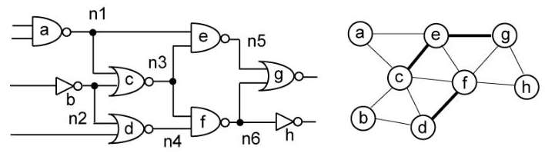
Kernighan-Lin (KL) Algorithm
“An Efficient Heuristic Procedure for Partitioning Graphs,” The Bell System Technical Journal, 49(2):291-307, 1970
Notes:
The first algorithm we are going to talk about in today’s lecture is Kernighan-Lin algorithm or KL algorithm. The original paper is entitled with “an efficient heuristic procedure for partitioning graphs” published in Bell Lab. This is an algorithm that targets partitioning a graph (not hypergraph) into two subgraphs of equal size, while minimizing the interconnect complexity. This essentially is bipartitioning.

Slide 29
Restricted Partition Problem
Restrictions
For Bisectioning of circuit (k=2, two-way partitioning)
Assume all gates are of the same size
Works only for 2-terminal nets
If all nets are 2-terminal, the hypergraph is called a graph
B
B
A
A
Hypergraph
Representation
Graph
Representation
C
D
C
D
Notes:
You probably can already guess the limitation of the algorithm comes from the target of the algorithm itself. KL algorithm targets only bisectioning of a circuit, … (explain)

Slide 30
Problem Formulation
Input: A graph with
Set vertices V (|V| = 2n)
Set of edges E (|E| = m)
Cost c_{AB} for each edge {A, B} in E
Output: 2 partitions X & Y such that
Total cost of edges cut is minimized
Each partition has n vertices
This problem has been proven to be NP-complete
Very difficult to find the optimal partition efficiently
Notes:
The formal problem description is as follows: (explain…)

Slide 31
A Naive Approach …
Try all possible bisections, find the best one
If there are 2n vertices,
# of possibilities =
For 4 vertices (A,B,C,D), 3 possibilities
1. X={A,B} & Y={C,D}
2. X={A,C} & Y={B,D}
3. X={A,D} & Y={B,C}
For 100 vertices, 5x10²⁸ possibilities
Need 1.59x10¹³ years if one can try 100M possibilities per second
= (2n)! / (2 × (n!²)) = n^{O(n)}

Slide 32
Idea of KL Algorithm
D_{A} = Decrease in cut value if moving A
External cost (connection) E_{A} – Internal cost I_{A}
Moving node a from block X to block Y would increase the value of the cutset by E_{A} and decrease it by I_{A}
X
B
Y
X
B
Y
C
C
= 2-1 = 1
= 1-1 = 0
D_{A} =
D_{B} =
A
D
A
D
Notes:
Turns out solving the problem with optimal solution is not practical. The idea of KL algorithm is to iteratively swap a pair of nodes from both side of the partition and terminate the iteration when no swaps are possible. When deciding the pair to swap, KL algorithm looks at the value “the decrease in cut value when moving a node from one side to the other side” and greedily pick the one that results in the most decrease.
This value is defined as D for each vertex. For instance, Da (explain …)

Slide 33
Idea of KL Algorithm
Note that we want to balance two partitions
If switch A & B, gain(A,B) = D_{a} + D_{b}?
X
Y
X
B
Y
B
C
C
D
A
A
D
gain(A,B) = 1+0 = 1?

Slide 34
Idea of KL Algorithm
Note that we want to balance two partitions
If switch A & B, gain(A,B) = D_{A} + D_{B} – 2C_{AB}
c_{AB :} edge cost for AB
X
Y
X
B
Y
B
C
C
D
A
A
D
gain(A,B) = 1+0-2 = -1

Slide 35
KL Algorithm
Start with any initial legal partitions X and Y
A pass (exchanging each vertex exactly once) is described below:
1. For i := 1 to n do
From the unlocked (unexchanged) vertices, choose a pair (A,B)
s.t. gain(A,B) is largest (greedy)
Exchange and Lock A, B
Let g_{i} = gain(A,B)
2. Find the k s.t. G=g₁+...+g_{k} is maximized
3. Switch the first k pairs
Repeat the pass until there is no improvement (G=0)
Notes:
With the decrease value defined, the KL algorithm works as follows: (explain)

Slide 36
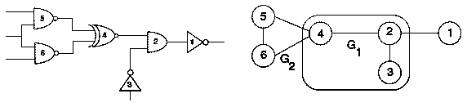
KL Algorithm Walkthrough – 1
2
1
3
5
4
6
Notes:
Let’s walk through the KL algorithm using an example. Here I have a circuit network of six gates labelled from 1 to 6. Then, I can represent their connection in a typical graph, not the hypergraph because we know we can always reduce a hypergraph into a typical graph by constructing a directed edge from one node to others.
The graph here looks like the following: (explain…)
Let’s start with an initial partition, which can be arbitrarily decided. For instance, I randomly partition the circuit into two groups, G1 and G2 (explain …)

Slide 37
KL Algorithm Walkthrough – 2
1-0 = 1
1-2 = -1
0-1 = -1
2-1 = 1
1-1 = 0
1-1 = 0
-1 + 1 – 2 = -2
-1 + 0 – 0 = -1
-1 + 0 – 0 = -1
-1 + 1 – 0 = 0
-1 + 0 – 0 = -1
-1 + 0 – 0 = -1
1 + 1 – 0 = 2
1 + 0 – 2 = -1
1 + 0 – 2 = -1
D₁ =
D₂ =
D₃ =
D₄ =
D₅ =
D₆ =
gain(2, 1) =
gain(2, 5) =
gain(2, 6) =
gain(3, 1) =
gain(3, 5) =
gain(3, 6) =
gain(4, 1) =
gain(4, 5) =
gain(4, 6) =
2
1
1
3
5
4
4
6
g₁
Notes:
With this initial partition, I can calculate the

Slide 38
KL Algorithm Walkthrough – 3
1 – 2 = -1
0 – 1 = -1
0 – 2 = -2
0 – 2 = -2
-1 + -2 – 0 = -3
-1 + -2 – 0 = -3
-1 + -2 – 0 = -3
-1 + -2 – 0 = -3
D₂ =
D₃ =
D₅ =
D₆ =
gain(2, 5) =
gain(2, 6) =
gain(3, 5) =
gain(3, 6) =
2
4
2
g₂
3
5
5
1
6

Slide 39
KL Algorithm Walkthrough – 4
D₃ =
D₆ =
gain(3, 6) =
1 – 0 = 1
1 – 1 = 0
1 – 0 – 0 = 1
g₃
5
4
g₁ = 2, g₂ = -3, g₃ = 1
Then ???
We need to find k
k = 1: g₁ =
k = 2: g₁ + g₂ =
k = 3: g₁ + g₂ + g₃ =
2
-1
0
3
3
2
5
4
1
6
6
6
2
1
3

Slide 40
KL Algorithm Walkthrough – 5
Since k = 1, we only take 1 move → swap (4, 1)
Finally, we get the result? NO! We only go 1 iteration (i.e., pass)!
Move on to the next iteration until converged
2
1
2
4
3
5
3
5
4
6
1
6

Slide 41
KL Algorithm Revisited
Start with any initial legal partitions X and Y
A pass (exchanging each vertex exactly once) is as follows:
1. For i := 1 to n do
From the unlocked (unexchanged) vertices,
choose a pair (A,B) s.t. gain(A,B) is largest (greedy)
Exchange and Lock A, B
Let g_{i} = gain(A,B)
2. Find the k s.t. G=g₁+...+g_{k} is maximized
3. Switch the first k pairs
Repeat the pass until there is no improvement (G=0)
A pass

Slide 42
Time Complexity of KL Algorithm
For each pass of KL
O(n²) time to find the best pair to exchange
n pairs exchanged
Total time is O(n³) per pass
Better implementation can get O(n²log n) time per pass
But requires fairly sophisticated data structure representation
Number of passes is usually small
Converged very fast in practice

Slide 43
Drawbacks of KL Algorithm
Handle only unit vertex weights
Vertex weights might represent block sizes, different from blocks to blocks in real situation
Handle only exact bisection
Need dummy vertices to handle the unbalanced problem
Handle only non-hypergraphs
Practical circuits have many terminal nodes for each cell output
Need to handle multi-terminal nets directly
B
A
A has two terminals, B and C!
C
D

Slide 44
Summary of KL Algorithm
1. Pair-wise exchange of nodes to reduce cut size
2. Allow cut size to increase temporarily within a pass
3. Compute the gain of a swap
Repeat
Perform a feasible swap of max gain
Mark swapped nodes “locked”
Update swap gains
Until no feasible swap
4. Find max prefix partial sum in gain sequence g₁, g₂, …, g_{m}
5. Make corresponding swaps permanent
6. Start another pass if current pass reduces the cut size
u •
v •
v •
u •
locked

